Slide 1
Big Data
A day without new knowledge is a lost day.
Before we start DBT module.
Which module(s) you have completed?

Slide 2
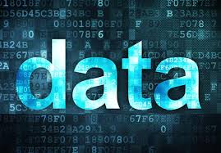
What is data?

Slide 3
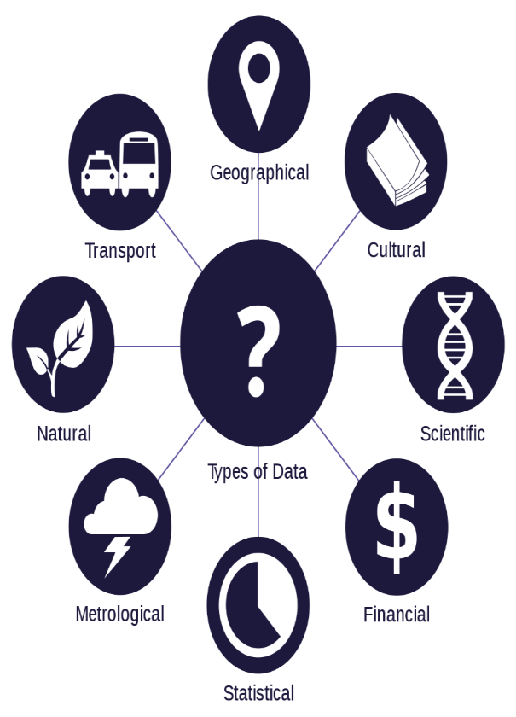
what is data
Data is any facts that can be stored and that can be processed by a computer.
Data can be in the form of Text or Multimedia
e.g.
number, characters, or symbol
images, audio, video, or signal

Slide 4
What is big data?

Slide 5
what is big data
Big Data is a collection of data that is huge in volume, yet growing exponentially with time. It is a data with so large size and complexity that none of traditional data management tools can store it or process it efficiently. Big data is also a data but with huge size.

Slide 6
Basic Concepts of Big Data

Slide 7
Characteristics of Big Data
It is used by many multinational companies to process the data and business of many organizations. The data flow would exceed 150 exabytes per day before replication.
There are five v's of Big Data that explains the characteristics.
5 V's of Big Data
Volume
Veracity
Variety
Value
Velocity

Slide 8
Volume
The name Big Data itself is related to an enormous size of data. Big data technologies can handle large amounts of data.
Big Data is a vast 'volumes' of data generated from many sources daily, such as business processes, machines, social media platforms, networks, human interactions, and many more.
Facebook can generate approximately a billion messages,
Billion times that the "Like" button is recorded,
and more than 350 million new posts are uploaded each day.

Slide 9
Veracity
Conformity to facts; accuracy.
Veracity means how much the data is reliable and accurate. It has many ways to filter the data. Veracity is the process of being able to handle and manage data efficiently.

Slide 10
Variety

Slide 11
Variety
Structured data: In Structured schema, along with all the required columns. It is in a tabular form. Structured Data is stored in the relational database management system.
Semi-structured: In Semi-structured, the schema is not appropriately defined, e.g., JSON, XML, CSV, TSV. It is stored in relations, i.e., tables.
Unstructured Data: All the unstructured files, log files, audio files, and image files are included in the unstructured data.
Quasi-structured Data: The data format contains textual data with inconsistent data formats that are formatted with effort and time with some tools.

Slide 12
Value

Slide 13
Velocity

